Slide 1
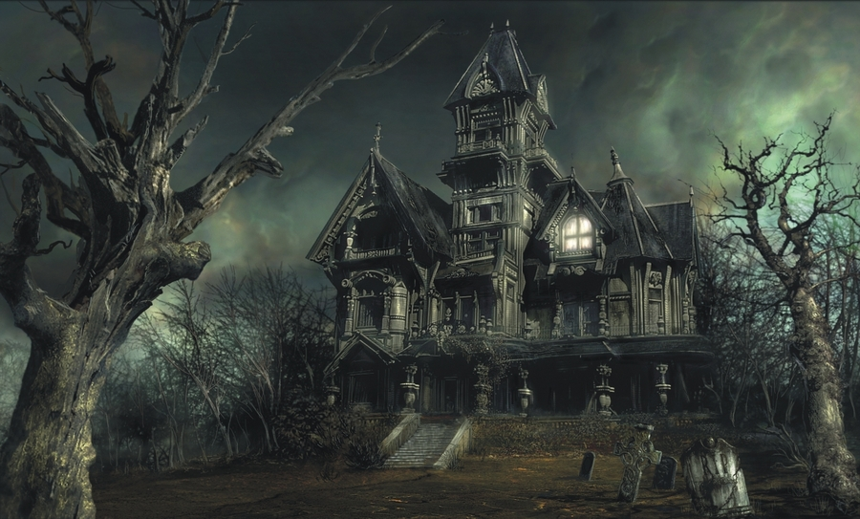
PYTHON HAUNTED HOUSE Part 4 Lost?

Slide 2
Quality of Life
We are going to try and add in some features to make the lives of our adventures a little easier.
The first is a map.
This will be drawn based upon the created rooms.
Textfile.py is going to be used over and over again so it makes sense to have it in it’s own separate module.

Slide 3
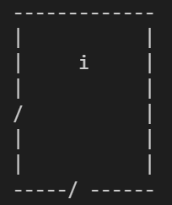
Map
We are going to draw something quite simple:
If the room has an enemy draw an “e”
If the room has an item draw an “i”
If the room links to another room draw a door.
In this example / is used for a door

Slide 4
Room.py
Create a backup of your room.py & main.py so if something goes wrong you can always go back a step.
Do this now.

Slide 5
Backups
Honestly, make sure you have done this.
Ask the person next to you to check that you have backed up your files.

Slide 6
Room.py
Create a new method called room_draw.
The logic:
We are going to create a 6 variables that are all set to false
4 x door directions
1 x item in a room
1 x enemy in a room
Do this now

Slide 7
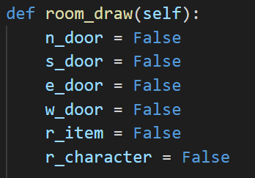
Room.py
Solution:

Slide 8


Room.py
Next we need to check if a room links to another room:
And if a room has an item in it:
Complete this for the other doors and enemy

Slide 9
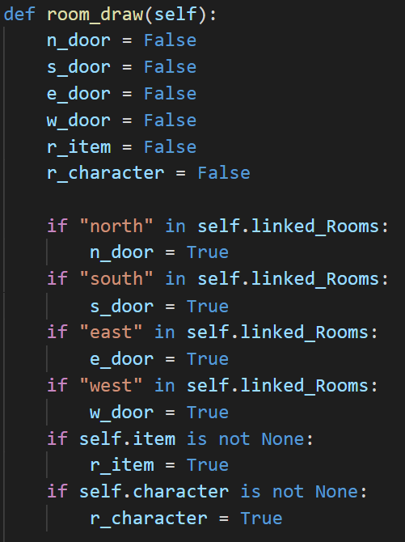
Room.py
Solution:

Slide 10
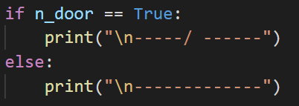
Room.py
Now we need to draw the room. If n_door is true we draw a door, if it is False we don’t.
Complete this for the remaining variables

Slide 11
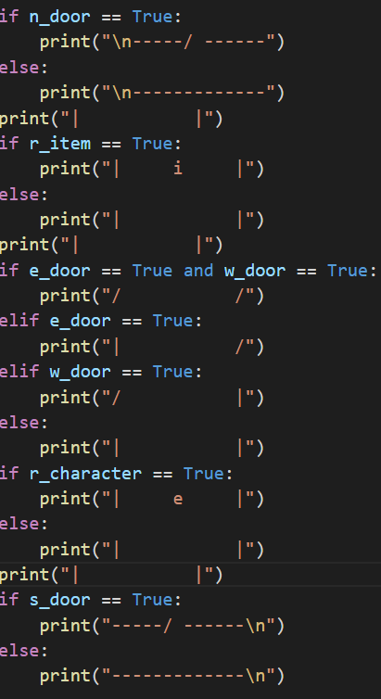
Room.py
Solution:
Careful here

Slide 12

Main.py
Have the room_draw method called near the top of the main game loop

